Slide 1

Air Mundial Pollution
Manuel Curral Marco Scavo

Slide 2
Index agenda
01
02
Ideia of our Project: Motivation
OUR PRODUCTS
03
04
Impact of project
EXPECTED PROJECTION
How we come to this idea
Describe the functionalities and features realized to this project
How this project is useful and apelativ. Clients(for people and organizations)
How We can do better and more

Slide 3
Idea of our project: Motivation
Air pollution is one of the biggest threats for the environment and affects everyone: humans, animals, crops, cities, forests, aquatic ecosystems…
Alarming Factors:
(health and social) 92% of people around the world do not breathe clean air;
(economical) Air pollution costs the global economy US $ 5 trillion per year;
(environmental) Ozone soil pollution is expected to reduce crop yields by 26% by 2030.

Slide 4


How choose Data and obtain usefull data to work
Notes:
Website and Através de uma tool online e trabalhamos em Javascript

Slide 5

Tecnologies
Notes:
recomendations of professor

Slide 6
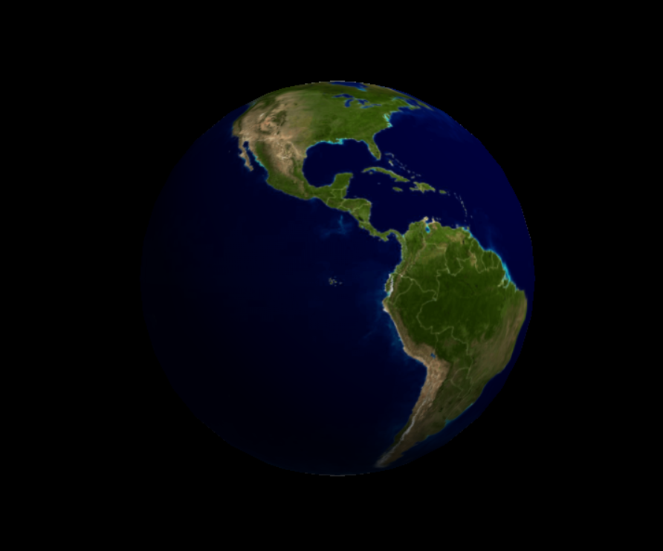
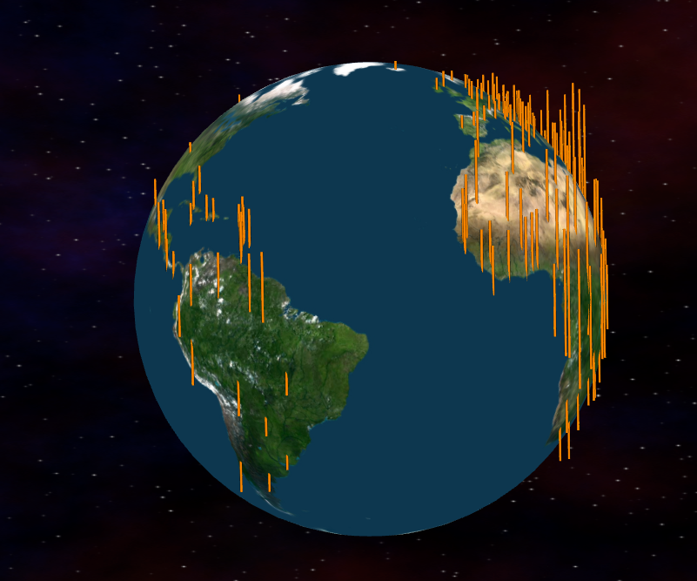
Evolution: main problems and How We supere them
Problem with illumination of all Earth
Bars did not calibrated and in right place some of theme
Notes:
recomendations of professor

Slide 7
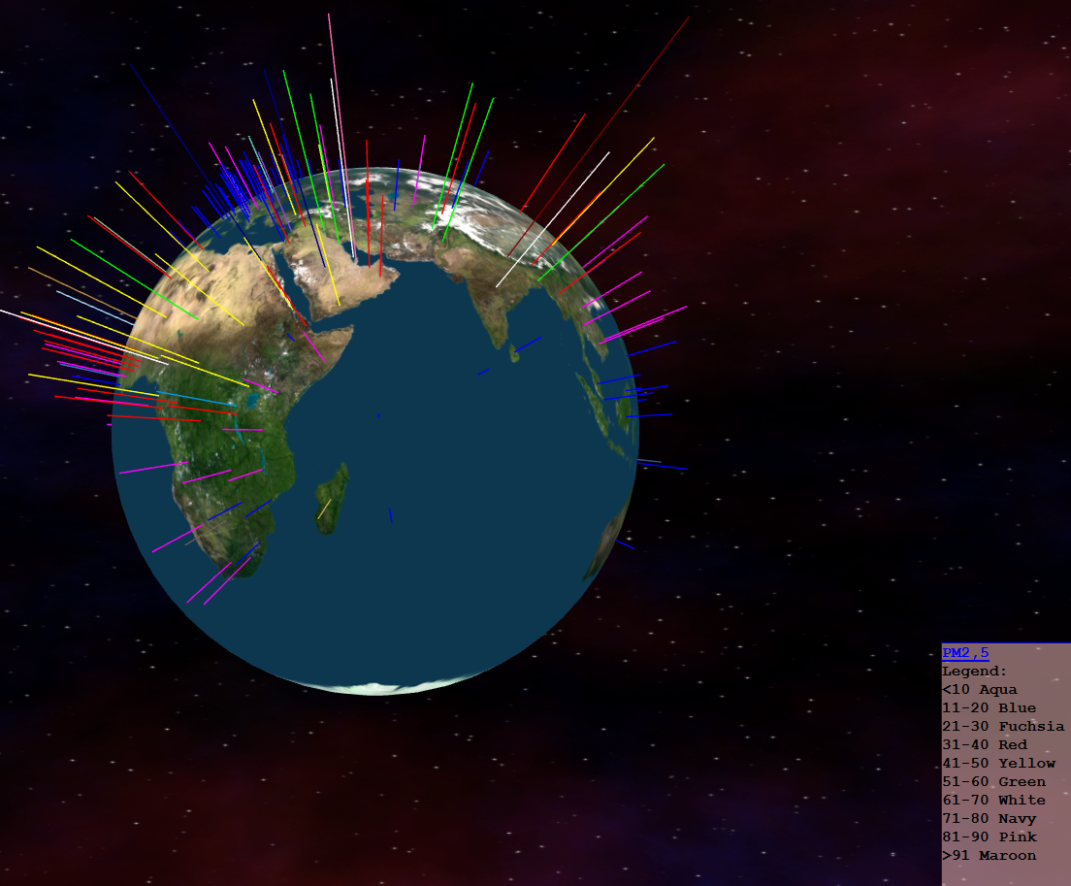
Our Product
Our product aims to be a global representation: visual and intuitive of the planet’s atmospheric pollution. The color and size of the bar makes it possible to distinguish between different countries and the size of the pollution.
In addition we have a tooltip that identifies us exactly country and pollution value.

Slide 8
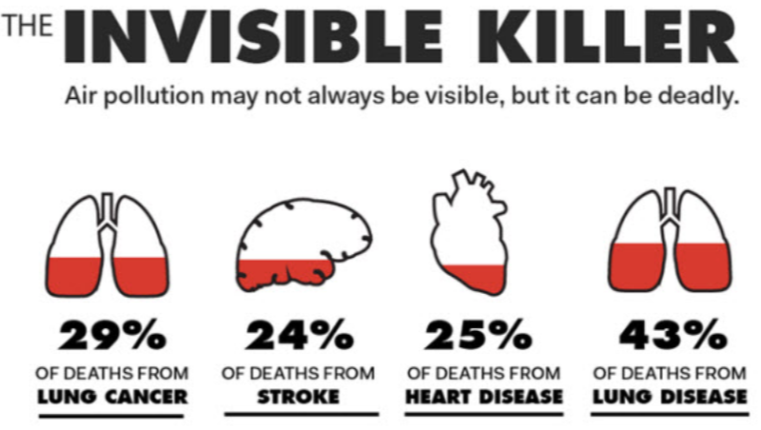
Impact of our Project :
Sensitize people, especially on public health and pollution campaign sites.
Commemorative Acts and Summits and Global Pollution Reduction Programs
2008
31 May
5 June
The EU's main 2020 targets:
-20% reduction in greenhouse gas emissions compared to 1990
share of 20% of energy from renewable sources in total consumption
20% increase in energy efficiency
2020
Mundial no Toobaco day
World Environment Day, which will have China
1
2
3

Slide 9
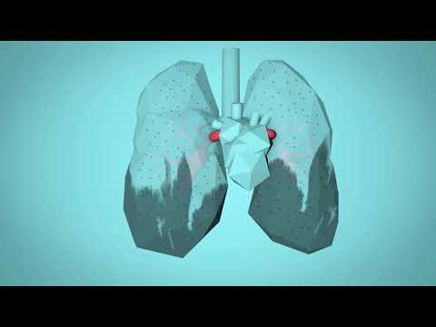
OUR STORY
2018
Neptune is the furthest planet in our Solar System
5

Slide 10

“There is a sufficiency in the world for man's need but not for man's greed”
—Mahatma Gandhi

Slide 11
E
Expected Projection & Future Work
Values
Vision
MISSION
To correlate this data with others about the diseases that kill people (especially heart disease, as shown in the video).
And thus have a greater impact that actually changes people's behavior
Representing Top 10 polluting countries of World and by Continent and Also Top 10 less polluting by same factors
Reuse Reduce Recycle

Slide 12

END of Presentation

Slide 13
...and our set of editable icons
You can resize these icons keeping the quality.
You can change the stroke and fill color; just select the icon and click on the paint bucket/pen.

Slide 14
Business Icons

Slide 15
Avatar Icons

Slide 16
Creative Process Icons

Slide 17
Educational Process Icons

Slide 18
Help & Support Icons

Slide 19
Medical Icons

Slide 20
Nature Icons

Slide 21
Performing Arts Icons

Slide 22
SEO & Marketing Icons

Slide 23
Teamwork Icons

